Slide 1
INTRO TO DATA CHALLENGE 2023
Team Indigo

Slide 2
Scenario Introduction: Building a Database Solution
for Bookworm’s Haven Scenario
Welcome to the presentation on the database solution designed and implemented for Bookworm’s Haven. In this presentation, we’ll explore how we’ve structured the database to manage online book inventory, customer details, and order processing.
We’ve been hired by Bookworm’s Haven to assist with their inventory management.Our quest was to design and implement a database system using SQL to help them keep track of their books,customers and order. Bookworm’s Haven has provided us with the following requirements to create….
1. Book Inventory Management: Store information about the books. We need to store each book's title, author, genre, publication year and price.
2. Customer Management: Store customer details. For each customer, we need to store their full name, email address and phone number.
3. Chapter Chaser Membership: Bookworm’s Haven also allows customers to sign up for their membership and become a Chapter Chaser allowing them to collect points with every purchase. We need to know if the customer is a Chapter Chaser or not.
4. Order Management: Store information about each order including which customer placed it, the books ordered and the total amount paid.

Slide 3
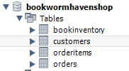
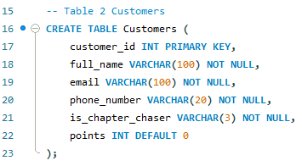
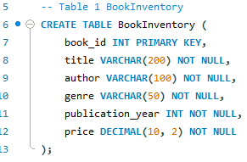
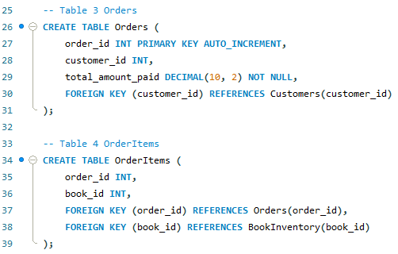
Step 1 - Relational Database Schema
Using the DDL Command ‘CREATE’, we created the main database Bookhavenshop.
In order to ensure our tables were then created in that specific database, we added the DDL
command ‘USE ‘
Using the command ‘CREATE’ again we designed a schema which reflects the main
components of the bookstore's operations: customers, bookinventory, orders, and order items.
The tables above hold information about customers and books within
the store’s inventory.
The tables below holds client’s orders information.
Separate tables for “orders” and “orderitems” allows for a more efficient and normalized database
structure reducing data redundancy, we can easily expand or modify the order management system, avoid duplicating book data for each order and it makes it easier to write queries and generate reports

Slide 4
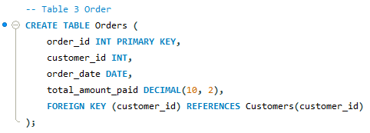
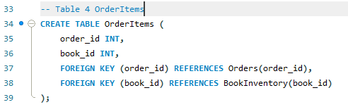
Step 2 - Primary and Foreign Keys
In a relational database, keys play a fundamental role in maintaining data integrity, ensuring accurate relationships between tables, and enabling efficient data retrieval.
In our database, primary keys are applied to the following tables:
Customers: customer_id (primary key) Uniquely identifies each customer. Crucial for managing customer-specific data, including orders and points.
BookInventory: book_id (primary key) Ensures each book in the inventory is uniquely identified, allowing easy tracking and management.
Orders: order_id (primary key) Provides an unique identifier for each order, enabling efficient order tracking and management.
Foreign keys establish relationships between tables by linking data in one table to data in another. In our
database:
Orders table: the customer_id field is a foreign key referencing the customer_id in the Customers table. This links each order to the corresponding customer who placed it.
OrderItems table: order_id and book_id are foreign keys. order_id references the order_id in the Orders table, connecting order items to their respective orders. book_id references the book_id in the BookInventory table, linking order items to specific books.
All 4 tables have a primary key but table 3 and 4 have foreign keys to create a relationship between the tables

Slide 5
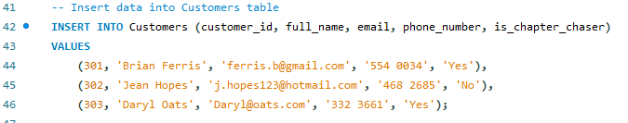
Step 3 - Inserting Data into the Tables
In order to add data into the tables created we used the DML command ‘INSERT’, used to insert new rows of data into a table. The basic syntax for ‘INSERT’ is as follows:
We inserted information into the customers table and inventory table first as these will be where order information is pulled from
We then used DML command ‘SELECT *’ to check that all information was added correctly.

Slide 6
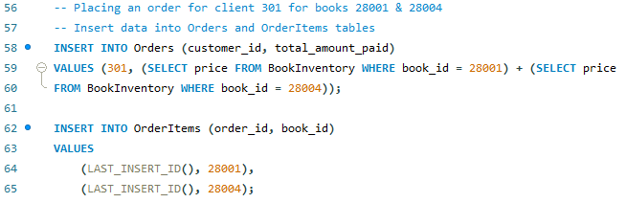
Step 3 - Placing Orders
We then needed to place an order. We used the following DML commands to
add data into the orders and orderitems:
• INSERT INTO Orders: Used to insert data into the “Orders” table. The INSERT INTO statement adds a new row into the “Orders” table, specifying the “customer_id” and “total_amount_paid” values for the order, manipulating data within the table.
• INSERT INTO OrderItems: Used to insert data into the “OrderItems" table, specifying the “order_id” and “book_id” values for each order item. Multiple rows are inserted using a single INSERT INTO statement, which is characteristic of DML actions.
(LAST_INSERT_ID () ensures that the next ID follows on from the previous one automatically, auto creating the next order number in the database

Slide 7


Step 3 - DML Command: UPDATE
‘UPDATE’ is used to modify data. In our database we chose it particularly for updating the
"is_chapter_chaser" status and customer points, Example:
UPDATE statement sets the is_chapter_chaser
column to 'yes' for customer with customer_id
301 using the ‘WHERE’ clause to update a specific row
UPDATE statement with a join between Customers and Orders tables. For each Chapter Chaser customer, we calculate points based on their orders' total amounts. The points are updated by multiplying the total_amount_paid by 100 and added to the existing points value.
Below we assigned the alias ‘c’ to the customers table and ‘o’ to the orders table, to
simplify the code and make it easier to read:
Advantages:
Efficiently updates points for Chapter Chasers.
Reflects customer loyalty through purchase history.
Loyalty rewards encourages continued engagement with Bookworm's Haven.

Slide 8
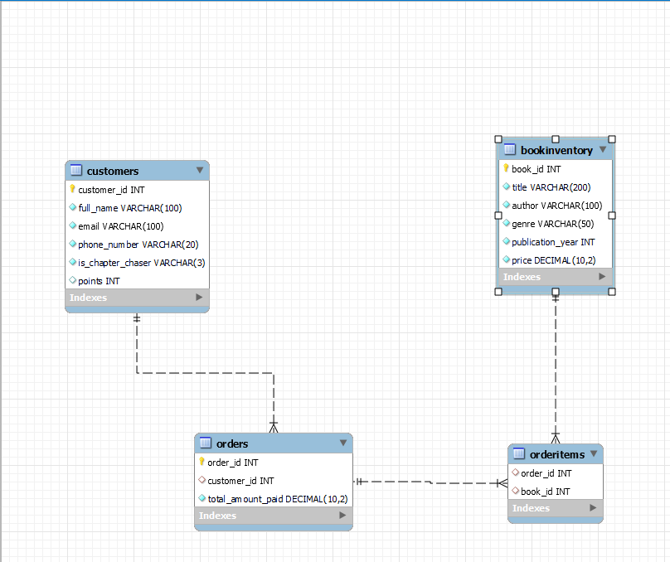
Step 4 - EER Diagram
Entity-Relationship (EER) diagram visually represents the relationships between tables in a database.
Customers are linked to Orders through the customer_id foreign key, reflecting the relationship between customers and their orders.
Orders are connected to OrderItems through the order_id foreign key, representing the composition of orders with individual book items.
OrderItems are associated with specific books in the BookInventory table through the book_id foreign key, forming a relationship between orders and the books they contain.

Slide 9
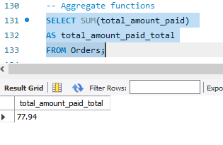
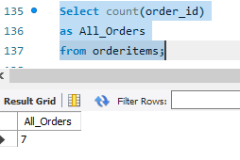
Using Aggregate functions
Aggregate functions in SQL allow us to perform calculations on sets of values and return a single result.
We used the following functions;
SUM, sum of all values in a column
COUNT, number of rows in a column
AVG, columns average value
MIN, lowest value in a column
MAX, highest value in a column
Using SUM, This can be used to help with balance for accounting purposes where the store needs to check the total amount paid balance for example. In order to know the total amount paid for all orders placed the SUM aggregate function as follows:
Here we show the COUNT of all books ordered. This shows how many books have been ordered total which could be used for inventory purposes:

Slide 10
•The database designed for Bookworm's Haven offers 3 main advantages:
•
•Efficient management of customer information and orders.
•Easy tracking of customer points for Chapter Chasers.
•Clear organization of book inventory details.
The database directly addresses the primary requirements of an online bookstore by facilitating customer interactions and order processing; Enabling data-driven insights through clear organization and efficient data retrieval, optimizing inventory management and decision-making.
•The Chapter Chaser points system fuels customer engagement.
Benefits of the Design

Slide 11
Conclusion
We introduced the core components of the database, including Customers, BookInventory, Orders, and OrderItems tables, forming the foundation for effective data management.
Showed the critical role of primary and foreign keys in maintaining data integrity and enabling accurate relationships between tables.
We delved into the possibility of using aggregate functions and their application in calculating Chapter Chaser points
We demonstrated how DML commands, specifically the UPDATE statement, are leveraged to modify and enhance customer information including chapter chaser points based on purchase amount paid per order.
We presented an Entity-Relationship (EER) diagram illustrating the interconnected relationships between Customers, Orders, and BookInventory.
All of the above supports what this database design empowers Bookworm's Haven operations with a system that optimizes customer interactions and experience, order processing, and
inventory management.

Slide 12
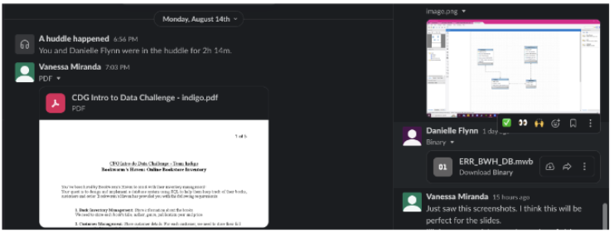
Evidence of Teamwork
The work was split between Danielle Flynn & Vanessa Miranda, each provided unique input for the tables Customers, BookInventory & Orders and worked conjointly in order to ensure the project was optimised for an online bookstore. We worked together via slack and huddles to ensure we both worked collaboratively.
Vanessa created the schema, structures and chapter chasers update commands, whilst Danielle was responsible for updating the tables, testing out the commands and creating the presentation slides.
Our main challenge was to ensure the
schema complied with normalization
rules and to implement a system to
automate the update of points for
chapter chasers. During a call which
lasted over 2h on the 14th of august.
the main points were discussed and
after 3 different schemas, we came up with the winner code for our project.

